Slide 1
Silver State Classic Challenge Marketing
January 2015
Tom King
Eric Pettersen

Slide 2
Our Marketing Objective
Increase participation in both the Nevada Open Road Challenge and the Silver State Classic Challenge
Why? To counteract:
aging of our loyal veterans
decreasing participation
increasing difficulty of getting volunteer workers
staleness factor of the events

Slide 3
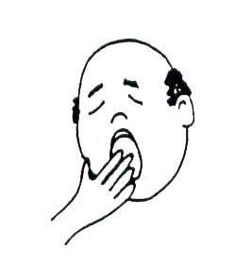
Our Current Market
Car guys from the generation that fell in love with cars – i.e., mostly old, rich, white men
Returning veterans
One-time, bucket-list rookies in the 110 mph class
Current marketing efforts: word of mouth, random You Tube postings, and not a lot else

Slide 4
Market Potential
People with nice street cars – they don’t need to be race-only cars!
People who track those nice street cars!
People who want to drive those increasingly-capable street cars faster and more safely than on the track!
People who want to preserve their marriage – hype navigator participation!

Slide 5
Specific Marketing Programs 1. Partnering
Partner with fast-growing track groups (Hooked-on-Driving, TrackMasters)
Offer special higher speed class for partner-certified drivers (Grand Touring for those who have demonstrated good track manners and capabilities)
Exchange email lists with these partners
Mount a recurring email campaign

Slide 6
Specific Marketing Programs 2. Formal You Tube Offerings
Re-do the introductory video, make it a link, and publicize via social media and email campaigns
Compile video snippets from the wide variety of videos currently available, add music and marketing commentary – publicize in the email campaign

Slide 7
Specific Marketing Programs 3. More Awards
Top Rookie
Best Rookie Navigator Story
Sportsmanship Award (to encourage behavior)
Best Hand-Timer Rookie
Other ideas?

Slide 8
Marketing Leadership
Appoint a Chief Marketing Officer
Negotiate formal agreements with partners
Provide stories and video to media on a consistent basis
Create and maintain recurring email campaigns
Strengthen the Chihuahua Express connection by emphasizing the Touring Class there
Spend some money on this

